Slide 1


Bison Inflation-Resilient Growth
January 2026

Slide 2



Bison Inflation-Resilient Growth
Strategy Objectives:
Diversify stock exposure while maintaining upside potential
Target assets with history of mitigating inflation risk
Risk profile similar to equities
Strategy Approach:
Blend of exposures with low correlations to equities
Diversification Benefits:
Low correlations
Differentiated return drivers
Potential to protect against
  Inflation
  Currency debasement
  Geopolitical shocks
OIL
GOLD
BITCOIN
Risk parity approach to asset allocation targeting equal contribution to risk based on the trailing 12-month risk profile
Add equity exposure when VIX is elevated (over 35)

Slide 3

Correlation Analysis
 | SPX | Gold | Oil | Bitcoin
SPX | 1.00 | 0.09 | 0.32 | 0.11
Gold | 0.09 | 1.00 | -0.15 | 0.07
Oil | 0.32 | -0.15 | 1.00 | 0.10
Bitcoin | 0.46 | 0.07 | 0.10 | 1.00
Low correlations to traditional asset classes and each other
Source: Bloomberg L.P., Bison Wealth, LLC
Correlation of monthly returns 12/31/2015 -10/31/2025.

Slide 4
Dynamic Risk Weighting
Risk Parity Approach
Allocate by risk rather than asset
Equal weight risk contribution from each asset
Quarterly rebalance to capture changing market environments
Add equity exposure during periods of elevated market volatility
Source: Bison Wealth, LLC
As of 10/31/2025

Slide 5
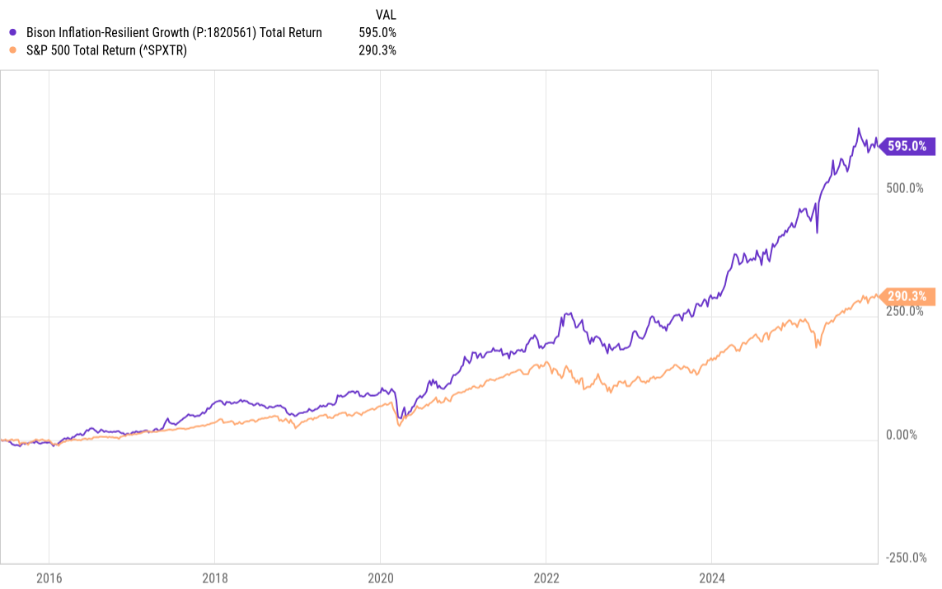
Returns
Source: Ycharts, Bison Wealth.
As of 12/31/2025
Hypothetical Performance:
Projected Returns are hypothetical and based on back tested model performance which assumes the holdings noted were held for the entire applicable period. Hypothetical performance is inherently misleading as it is calculated with the benefit of hindsight and does not consider actual market conditions or trading or other actions that would have been taken had the portfolio been managed. Performance is net of internal fund fees and a management fee of 0.45% but does not consider other fees such as transaction or custodial fees which may be applicable to an investor’s account. Actual account performance will vary. Performance noted is for informational purposes only and should not be relied up on when making investment decisions. Past performance, hypothetical or otherwise is not indicative of future performance.

Slide 6
Period Returns
Source: Ycharts, Bison Wealth.
As of 10/31/2025
Hypothetical Performance:
Projected Returns are hypothetical and based on back tested model performance which assumes the holdings noted were held for the entire applicable period. Hypothetical performance is inherently misleading as it is calculated with the benefit of hindsight and does not consider actual market conditions or trading or other actions that would have been taken had the portfolio been managed. Performance is net of internal fund fees and a management fee of 0.45% but does not consider other fees such as transaction or custodial fees which may be applicable to an investor’s account. Actual account performance will vary. Performance noted is for informational purposes only and should not be relied up on when making investment decisions. Past performance, hypothetical or otherwise is not indicative of future performance.

Slide 7
Risk And Return Benefits to Incorporating Into a Traditional Balanced Portfolio
 | Bison Inflation-Resilient | S&P 500 | Traditional 60/40 | Traditional 60/40 + 20% to Inflation-Resilient
5 Year Ann. Ret. | 22.17% | 14.40% | 8.49% | 11.31%
5 Year Std. Dev. | 15.62% | 14.84% | 10.16% | 9.64%
5 Year Sharpe | 1.21 | 0.75 | 0.52 | 0.84
5 Year Sortino | 2.25 | 1.08 | 0.74 | 1.16
Max Drawdown | 24.67% | 24.53% | 20.83% | 18%
Beta to S&P 500 | 0.45 | 1.00 | 0.70 | 0.68
Source: Ycharts. As of 12/31/2025.
Hypothetical Performance:
Projected Returns are hypothetical and based on back tested model performance which assumes the holdings noted were held for the entire applicable period. Hypothetical performance is inherently misleading as it is calculated with the benefit of hindsight and does not consider actual market conditions or trading or other actions that would have been taken had the portfolio been managed. Performance is net of internal fund fees and a management fee of 0.45% but does not consider other fees such as transaction or custodial fees which may be applicable to an investor’s account. Actual account performance will vary. Performance noted is for informational purposes only and should not be relied up on when making investment decisions. Past performance, hypothetical or otherwise is not indicative of future performance.
Traditional 60/40 is comprised of a balanced benchmark consisting of 60% S&P 500 Index and 40% Bloomberg US Aggregate Bond Index. Benchmark definitions are provided in the disclosures at the end of the presentation.

Slide 8
Stress Test
Source: YCharts., Bison Wealth, LLC
Hypothetical Performance:
Projected Returns are hypothetical and based on back tested model performance which assumes the holdings noted were held for the entire applicable period. Hypothetical performance is inherently misleading as it is calculated with the benefit of hindsight and does not consider actual market conditions or trading or other actions that would have been taken had the portfolio been managed. Performance is net of internal fund fees and a management fee of 0.45% but does not consider other fees such as transaction or custodial fees which may be applicable to an investor’s account. Actual account performance will vary. Performance noted is for informational purposes only and should not be relied up on when making investment decisions. Past performance, hypothetical or otherwise is not indicative of future performance.

Slide 9
Disclosures
Advisory services provided by Bison Wealth, LLC (“Bison”) an SEC registered investment adviser. Registration does not imply a certain level of skill or training. The information contained herein is for informational purposes only and should not be deemed an offer or solicitation to purchase or sell an investment product or service. The model portfolio(s) noted may change without notice at the discretion of the portfolio manager.
Some strategies are provided by Liquid Strategies, LLC a registered investment adviser under common ownership with Bison. Diversification does not guarantee profits or protect against loss. All investments contain risk to include the total loss of invested principal. Past performance is not indicative of future results. Not all investment strategies are appropriate for all investors. Investors should consult with their tax, legal and/or financial professional and consider the investment objectives, risk factors, charges, expenses and tax implications before investing.
Bison does not provide tax or legal advice. Additional information about Bison to include its services and fees can be found in its Form ADV which is available upon request or can be found at www.adviserinfo.sec.com.
Hypothetical Performance:
Projected Returns are hypothetical and based on back tested model performance which assumes the holdings noted were held for the entire applicable period. Hypothetical performance is inherently misleading as it is calculated with the benefit of hindsight and does not consider actual market conditions or trading or other actions that would have been taken had the portfolio been managed. Performance is net of internal fund fees and a management fee of 0.45% but does not consider other fees such as transaction or custodial fees which may be applicable to an investor’s account. Actual account performance will vary. Performance noted is for informational purposes only and should not be relied up on when making investment decisions. Past performance, hypothetical or otherwise is not indicative of future performance.
Benchmark represents a Benchmarks and indices shown are provided for illustrative purposes only, are unmanaged, and do not reflect the impact of advisory fees or other costs. Investors cannot invest directly in an index. Comparisons to indexes have limitations because the model portfolio will not necessarily include all the securities included within the index. Models may have a blend of one or more indices. See disclosures for benchmark definitions.

Slide 10
Disclosures (continued)
Terms & Definitions:
Benchmarks:
The S&P 500 Index seeks to track 500 large cap companies in the US, weighted by market capitalization.
The Bloomberg US Aggregate Bond Index is a broad-based benchmark that seeks to measure the investment grade, dollar denominated fixed-rate taxable bond market. The index includes Treasuries, government-related and corporate securities, and fixed-rate agency mortgage and asset-backed securities.
Terms:
Standard Deviation: Standard deviation is a measure used to show the potential range of returns that a portfolio could experience over a one-year period. The wider the range, the more uncertainty, and therefore the riskier the asset or portfolio is assumed to be.
Sharpe Ratio: Measure of the portfolio’s historical return per unit of risk (standard deviation) over the chosen performance period.
Sortino Ratio: Measures the excess return of an investment above a risk-free rate relative to downside volatility, isolating harmful volatility by only considering negative returns in the calculation.
Max Drawdown: A measure of the maximum observed loss from a peak to a trough of a portfolio, before a new peak is attained. Maximum drawdown is an indicator of downside risk over a specified time period.
Beta to S&P 500: Beta is a measure of how the portfolio responds to the volatility of the S&P 500 Index. It can be interpreted as the amount of market volatility relative to the S&P 500 Index volatility. A beta of 1.0 suggests that a portfolio’s volatility and returns may be similar to the S&P 500. Portfolios with betas greater than 1.0 are more sensitive to moves in the S&P 500, while portfolios with betas less than 1.0 are less sensitive to the performance of the S&P 500 Index.
Correlation: Measures the statistical relationship between two variables or assets, indicating the degree to which they move together, with values ranging from -1 (move oppositely) to +1 (move in the same direction)

